Slide 1

Data Structure & Algorithm
Lecture#11

Slide 2
Topological Order or Topological Sort
Topological sort is a technique used in graph theory to order the vertices of a directed acyclic graph (DAG).
It ensures that for every directed edge from vertex A to vertex B, vertex A comes before vertex B in the ordering.
This is useful in scheduling problems, where tasks depend on the completion of other tasks.

Slide 3
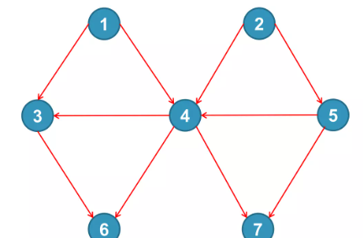
Example 1
Identify nodes having in degree 0.
Select a node and delete it with its edges then add node to output.
Output:
1 2 5 4 3 6 7

Slide 4
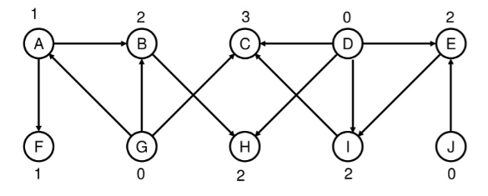

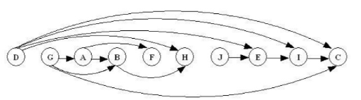
Example 2
Output:
Sorted Graph

Slide 5
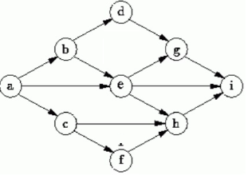
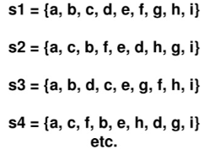
Topological sort is not unique
Output:

Slide 6
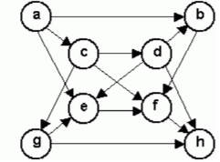
Class Assignment#1
List the order in which the nodes of the directed graph are visited by topological order traversal that starts from vertex a.

Slide 7
Class Assignment#2
Generate a directed graph to show the courses along with their prerequisites offer in the university .

